Slide 1
WATERFALL CHART

Slide 2
WHAT IS WATERFALL CHART?
A typical is used to show how an initial value is increased and decreased by a series of intermediate values leading to a final value.
One of the most popular visualization tools used in small and large businesses, especially in finance.

Slide 3
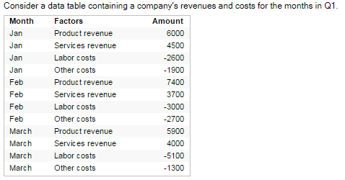
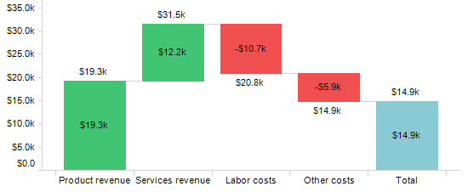
EXAMPLE

Slide 4
ADVANTAGES
Analytical Purposes
Quantitative Analysis
Tracking contracts

Slide 5
DISADVANTAGES
The waterfall chart is not relevant for detailed analysis of the data as you can’t make selections in the chart or expand the data.

Slide 6
TOOLS AND TECHNOLOGIES
Excel
Tableau
PowerBI
R
Python

